Slide 1
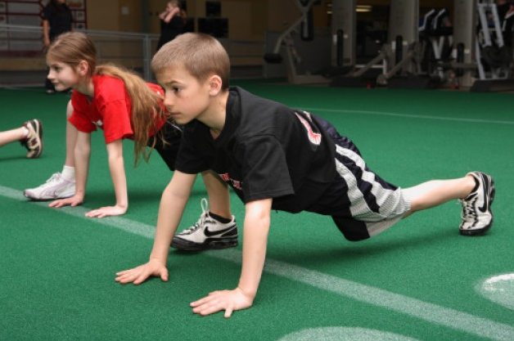
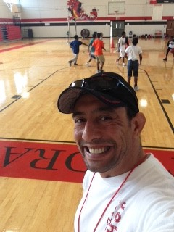
Coach John Oliverio

Slide 2

My Contact Information
olivejo@boe.richmond.k12.ga.us
Find me on Remind @joliverio
https://www.rcboe.org/Domain/12184
School Number 706-737-7288

Slide 3

Daily Schedule
9:20 – 9:55 Planning
9:55- 11:025 7th Grade
11:25- 12:15 Planning/ Lunch
12:15- 1: 45 6th Grade
1:45 – 2:35 Planning
2:35 – 4:05 8th Grade

Slide 4
Arrival and Dismissal
Morning Arrival
Drop off your child on Dragons Way behind the school
Morning Drop off time for car riders 8:50 A.M.
Early drop off students are unsupervised. Please remain with your child until 8:50 A.M. when teachers report for duty.
Afternoon Dismissal
Bus riders will report to bus loading zone
Walkers are dismissed from the bus loading zone where the crossing guard is located
Car Riders pick up time 4:05 p.m.

Slide 5

CHECKOUT MY WEBSITE TO VIEW THE FOLLOWING INFORMATION
Week At A Glance (WAG)
Class Syllabus/Supply List
Resources
Additional Information

Slide 6

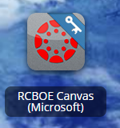
RCSS Learning Platform and Canvas
New to the Richmond County
Go to rcboe.org
Click Student
Click Launch Pad
Watch logging into Canvas as a student.
https://rcboe.instructuremedia.com/embed/048204ea-777e-4c04-9fc0-357111372c96
Your child will login through Launch Pad to access RCBOE Canvas.
Click link to watch Tutorial Video
https://www.rcboe.org/Domain/16265

Slide 7
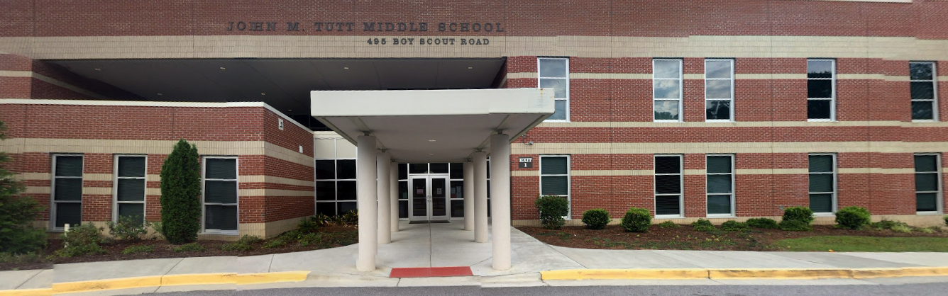
THANK YOU FOR VISITING JOHN M. TUTT MIDDLE SCHOOL

